Slide 1

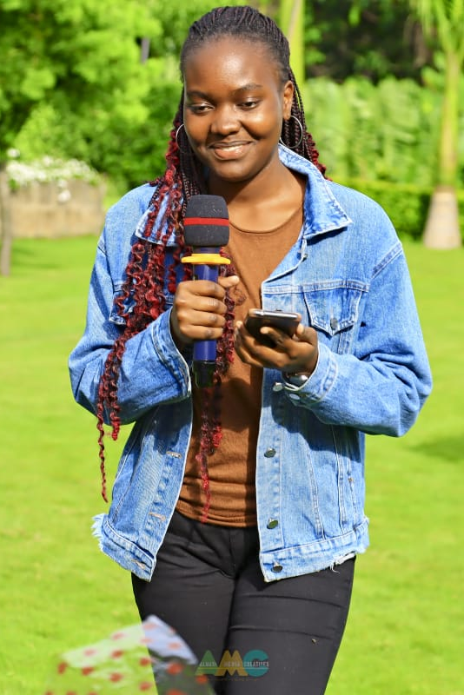
REFLECTIONS OF
A JOURNEY:
The Life and Career of
Rochelle Awuor
A Glimpse into My Life

Slide 2
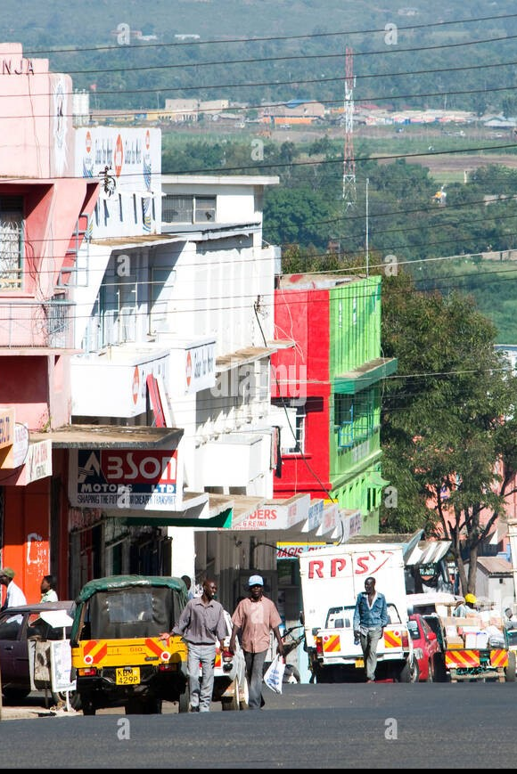

Early Life and Background
Childhood Beginnings:
I was born in Kisumu County on 12th May,2001 to Mr. George Ogeka and Ms Vivian Atieno Owango.
Family Background:
My family has always been my pillar of strength. My mother, in particular, played a significant role in shaping the person I am today.
Where I Was Raised:
I was raised in a vibrant community in Kisumu county that was rich in culture and tradition. The neighborhood where I grew up was filled with people from diverse backgrounds.

Slide 3
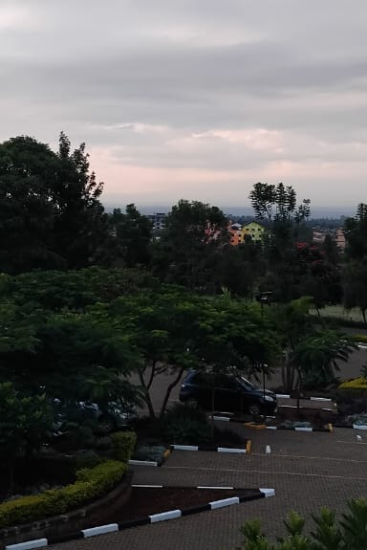
Education and Academic Pursuits
Primary and Secondary School Experiences:
Attended Golden Elites school in Kisumu and Star Sheikh Academy in Machakos while in primary school.
Joined St Mary’s Girls High school Igoji in Meru and finalized in St.Teresa Girls Secondary School in juja.
Developed a passion for drama, joining the drama club and showcasing acting talent.
Higher Education Journey:
Pursuing a Bachelor of Science in Business Information Technology (BBIT) at Dedan Kimathi University of Technology
Gained technical skills in programming, data analysis, and digital marketing.

Slide 4
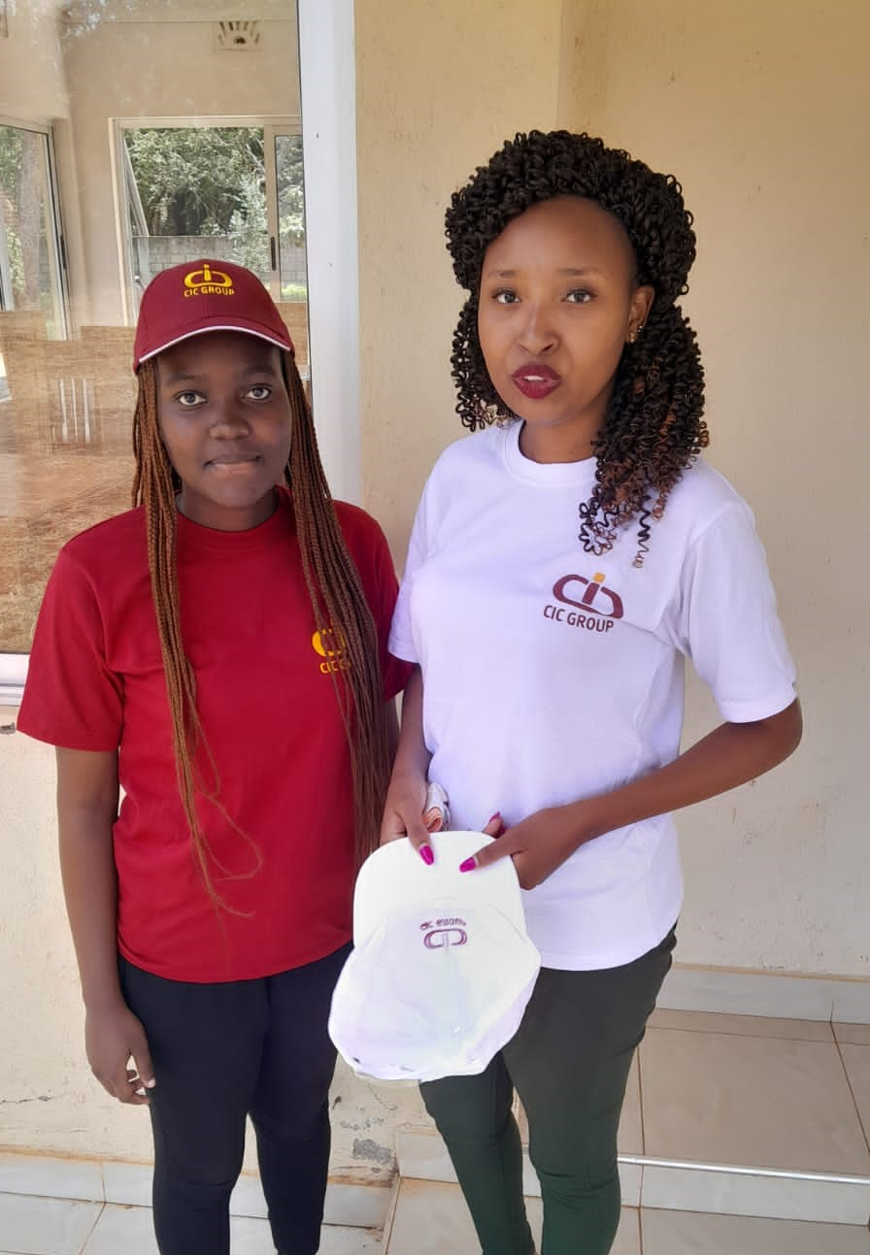
Professional Journey
Early Work Experiences:
Gained valuable experience at CIC Insurance as a Financial Advisor, enhancing client communication and financial planning skills.
Worked at Mwalimu Sacco, focusing on record documentation, which improved organizational skills and attention to detail.
Key Milestones:
Transitioned into the BBIT field, blending business knowledge with technological expertise.
Achieved proficiency in programming and networking, laying a strong foundation for future IT endeavors.
Professional Growth:
Dedicated to growth and excellence, leveraging a combination of financial advisory and IT skills to make meaningful contributions in cross-disciplinary roles.

Slide 5
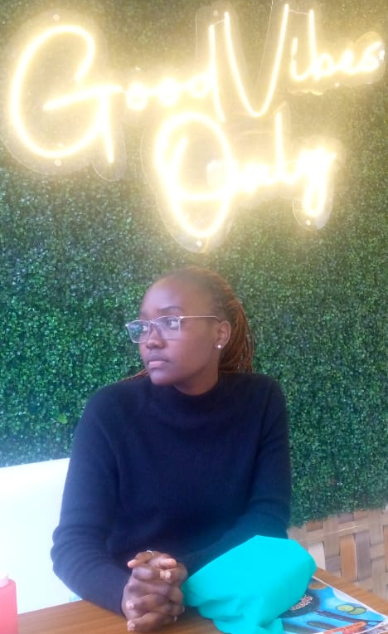
Personal Interests and Hobbies
Love for Reading:
Nurtured by my mother with storybooks in childhood.
Fostered a lasting love for literature.
Enhanced knowledge and communication skills.
Acting and Drama:
Creative outlet initiated in secondary school drama club.
Developed self-expression and public speaking confidence.
Reached finals in a school drama competition.
Cooking:
Cherished hobby focused on experimenting with flavors.
Creating joyful dishes for family and friends.
A therapeutic way to express love and care.

Slide 6
Relationships
Family:
My family has been a foundational influence, instilling core values such as resilience, compassion, and the importance of education. Through their support and guidance, I learned valuable lessons about responsibility, the significance of strong bonds, and the power of love in overcoming challenges.
Friendships:
Friendships have played a crucial role in shaping my character and experiences. The connections I’ve made over the years have provided support during difficult times and joy during celebrations.
Mentorship
I’ve been fortunate to have mentors who guided and inspired me throughout my journey. Their encouragement and wisdom have helped me navigate challenges and seize opportunities, significantly impacting my personal and professional growth.
Community:
My involvement in community activities has fostered a sense of belonging and purpose. Engaging with diverse groups has shown me the importance of giving back and supporting one another.

Slide 7
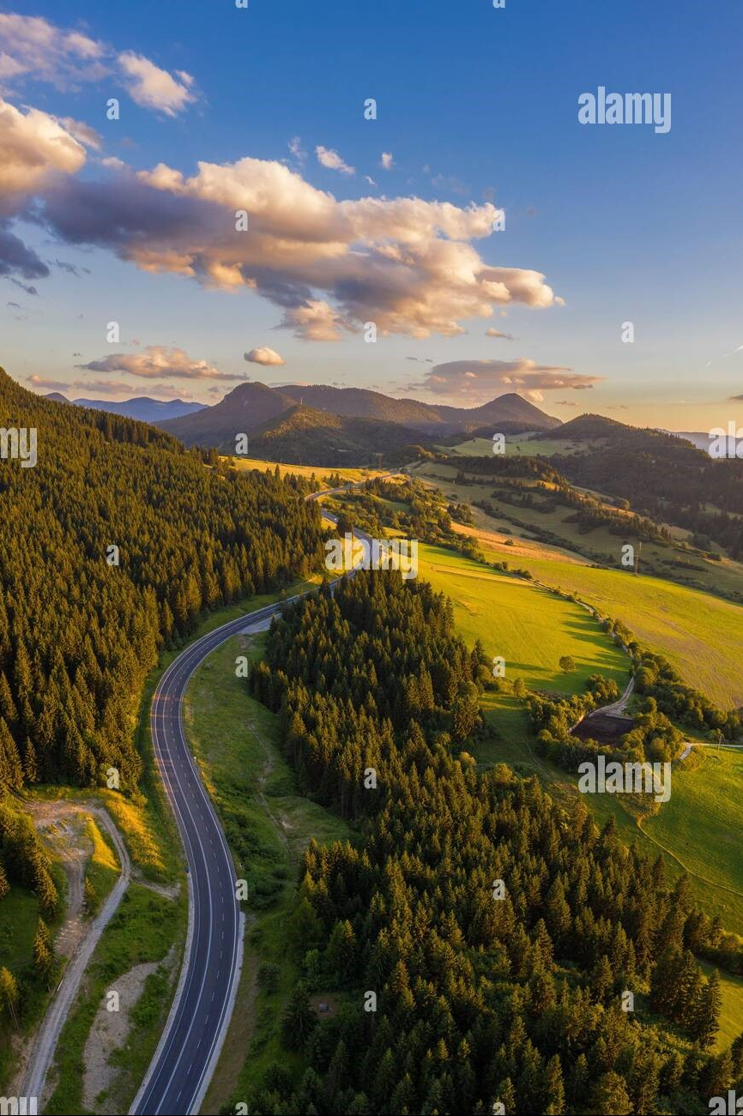
Conclusion and Future Aspirations
Conclusion:
Reflecting on my journey fills me with gratitude and introspection. Each experience,joyful and challenging,has contributed to my growth and resilience.
Key milestones, from my nurturing love for reading to significant achievements like enrolling in my Bachelor's degree, have shaped my character and reinforced my dedication.
Challenges, including financial struggles and academic setbacks, have taught me the importance of perseverance and self-discovery, transforming failures into opportunities for growth.
I am immensely thankful for the support from my family, especially my mother, and the positive influence of friends, mentors, and teachers who have inspired and guided me
Future Aspirations:
I aim to continue pursuing personal and professional growth, particularly in technology and business.
My goal is to make a positive impact in my community, fostering connections that promote mutual support and growth.
I plan to explore new creative ventures, including acting and cooking, sharing my passions with others and inspiring them along the way.

